Slide 1
ABAP Part I
Lesson 01: R/3 Architecture

Slide 2
Lesson Objectives
After completing this lesson, participants will be able to -
Know the meaning of ERP and SAP
Understand the R/3 system
Understand the Basics of SAP
Log on to SAP and do the Basic Navigations

Slide 3
Introduction to ERP
What is ERP?
E – Enterprise R – Resource P – Planning
Definition:
An integrated information system that serves all departments within an
enterprise.
ERP is a way to integrate the data and processes of an Organization into
one single system.
Software solution that addresses the enterprise needs taking the process
View of an organizational goals tightly integrating all functions of an enterprise

Slide 4
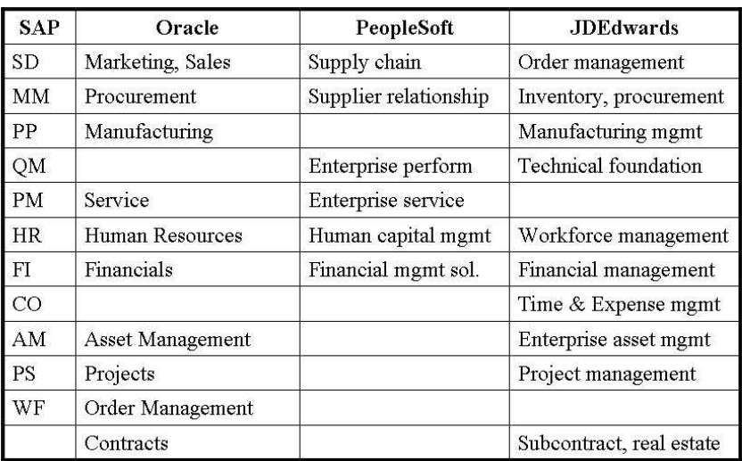
Introduction to ERP

Slide 5
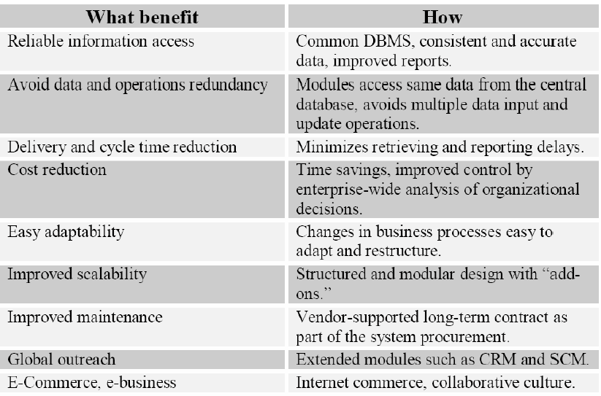
Introduction to ERP

Slide 6
Introduction to SAP
What is SAP?
S – Systems A – Applications P – Products in Data Processing
SAP, was started in 1972 by five former IBM employees in Mannheim, Germany, states that it is the world's largest inter-enterprise software company and the world's fourth-largest independent software supplier, overall.
SAP have a very high level of integration among its individual applications which guarantee consistency of data throughout the system and the company itself

Slide 7
SAP Technical and Functional Modules
Functional Modules
FICO – Finance & Control
PP – Production Planning
MM – Material Management
SD – Sales & Distribution
HR – Human Resources
Technical Modules
ABAP – Advanced business applications programming
XI – Exchange Infrastructure
Basis –
BIW – Business Information Warehousing

Slide 8
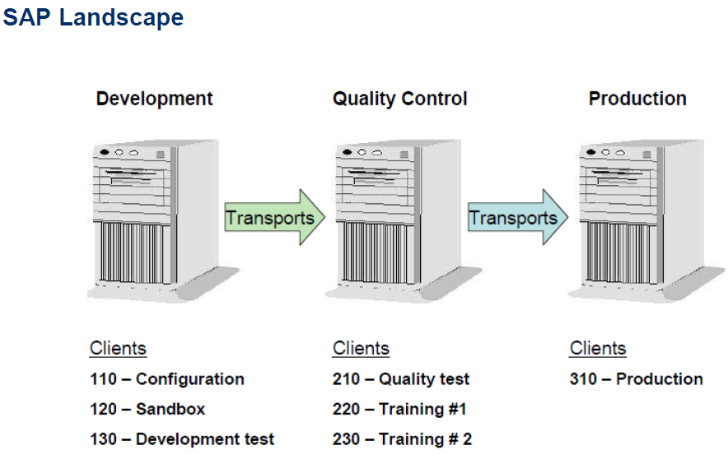
SAP Landscape

Slide 9
Introduction to NetWeaver
NetWeaver is SAP’s platform for composition and integration of loosely coupled applications following Service Oriented Architecture The Application Platform is the runtime environment for SAP NetWeaver.
Supports two languages (ABAP and Java) at the same time
ABAP – Advanced Business Application Programming

Slide 10
Why R/3
The main purpose of an R/3 system is to provide a suite of tightly integrated, large-scale business applications. The standard set of applications delivered with each R/3 system are the following:
PP (Production Planning)
MM (Materials Management)
SD (Sales and Distribution)
FI (Financial Accounting)
CO (Controlling)
AM (Fixed Assets Management)
PS (Project System)
WF (Workflow)
IS (Industry Solutions)
HR (Human Resources)
PM (Plant Maintenance)
QM (Quality Management)
Notes:
The above applications are called the functional areas, or application areas, or at times the functional modules of R/3. All of these terms are synonymous with each other.

Slide 11
Defining R/3
R/3 means Real-time 3-tier Architecture
R/3 software supports all of a company’s business transactions and links them together using real-time integration
Real-time integration means that each change or update in one application causes the automatic change or update of the data in the other applications involved.
R/3 also represents 3-tiered Client-Server Architecture.
The three Logical Layers of this R/3 Architecture are…
The Presentation Layer: Collects user input and creates process request.
The Application Layer: Uses the Application logic of Program to collect and process request.
The Database Layer: Stores and Retrieves all Data.

Slide 12
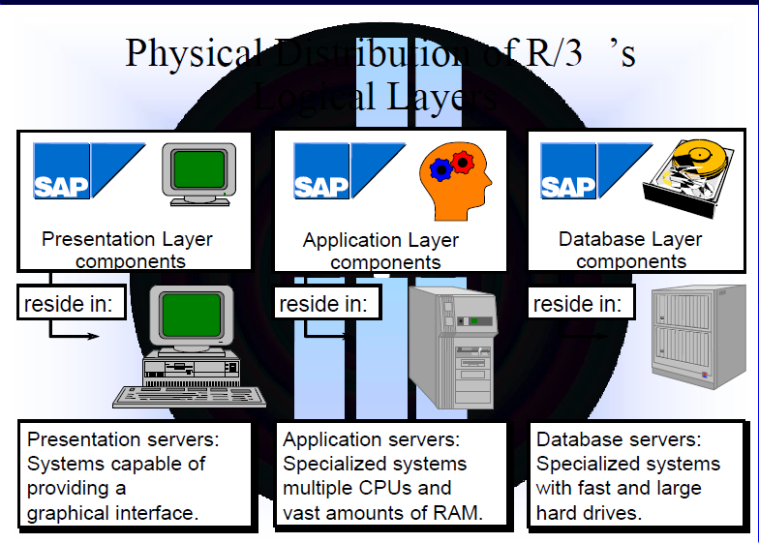
SAP R/3 Architecture

Slide 13
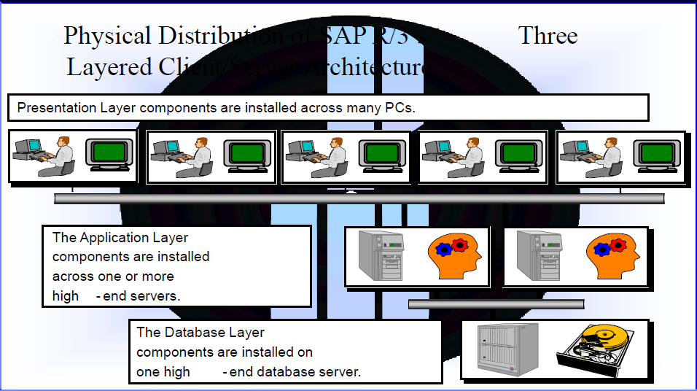
SAP R/3 Architecture

Slide 14
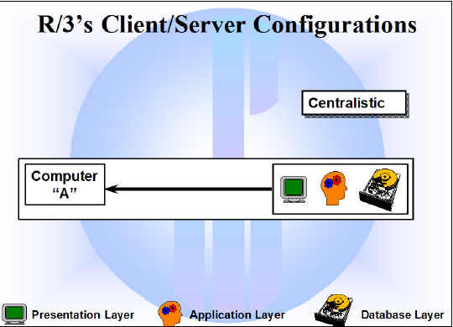
SAP R/3 Architecture
Centralistic:
All SAP R/3 layers reside on the same physical computer. One important distinguishing characteristic between the various R/3 client/server configurations is “Scalability”.
If a configuration is scalable, adding additional computers to the system will increase the overall performance of the system.
Centralistic client/server configurations are not scalable at all.
Consequently, this configuration is never used in a production environment.
SAP has actually installed an entire SAP R/3 system on a notebook computer for use by SAP’s sales representatives

Slide 15
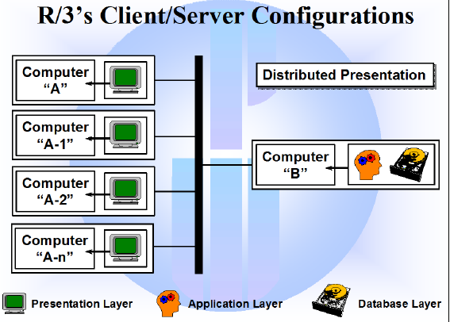
SAP R/3 Architecture
Distributed presentation:
The presentation layer is “rolled out” to desktop PCs.
The application layer and the database layer are installed on the same computer.
In terms of increased performance, the Distributed presentation configuration is no more scalable than the centralistic configuration. This configuration is very “mainframe”-”ish”

Slide 16
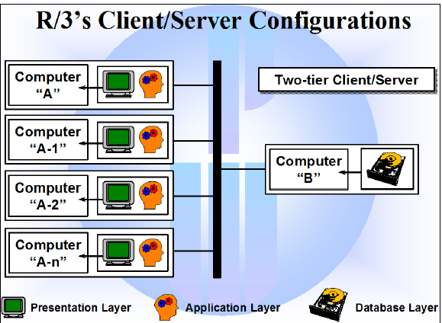
SAP R/3 Architecture
Two-tier client/server :
The presentation and application layers are installed on the same computer. The database layer is installed on a separate computer.
Two-tier client/server configurations offer increased scalability.
However, two-tier client/server configurations create other problems.
The communication across the network between the front-end (presentation and application layers) and the backend (database layer) becomes a bottle-neck very quickly

Slide 17
SAP R/3 Architecture
Three-tier client/server:
Presentation, application, and database layers run on separate computers.
Currently, three-tier client/server offers the best solution for most businesses.
It is highly scalable, and offers better distribution of process requests received from the users.
The computers in the application layer are often capable of satisfying the users process requests without accessing the database, which in turn boosts performance.

Slide 18
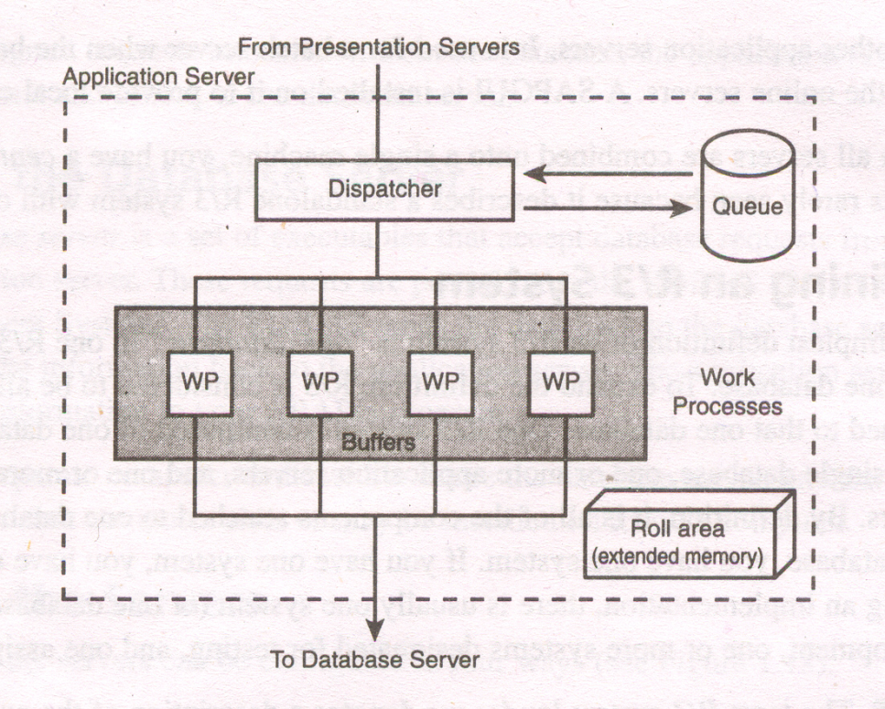
Application Server Architecture
The components of an application server are shown in the figure below. It consists of a dispatcher and multiple work processes.
Fig: Application server architecture

Slide 19
Application Server Architecture
All requests that come in from presentation servers are directed first to dispatcher.
The dispatcher writes them first to the dispatcher queue.
The dispatcher pulls the requests from the queue on a first-in, first-out basis.
Each request is then allocated to the first available work process.
A work process handles one request at a time.
To perform any processing for a user’s request, a work process needs to address two special memory areas: the user context and the program roll area.
The user context is a memory area that contains information about the user, and the roll area is a memory area that contains information about the programs execution

Slide 20
User Context
A user context is memory that is allocated to contain the characteristics of a user that is logged on the R/3 system.
It holds information needed by R/3 about the user, such as:
The user’s current settings
The user’s authorizations
The names of the programs the user is currently running
When a user logs on, a user context is allocated for that logon.
When they log off, it is freed.

Slide 21
Roll Area
A roll area is memory that is allocated by a work process for an instance of a program.
It holds information needed by R/3 about the program’s execution, such as:
The values of the variables
The dynamic memory allocations
The current program pointer
Each time a user starts a program, a roll area is created for that instance of the program.
If two users run the same program at the same time, two roll areas will exist-one for each user.
The roll area is freed when the program ends.
The roll area and the user context play an important part in dialog step processing

Slide 22
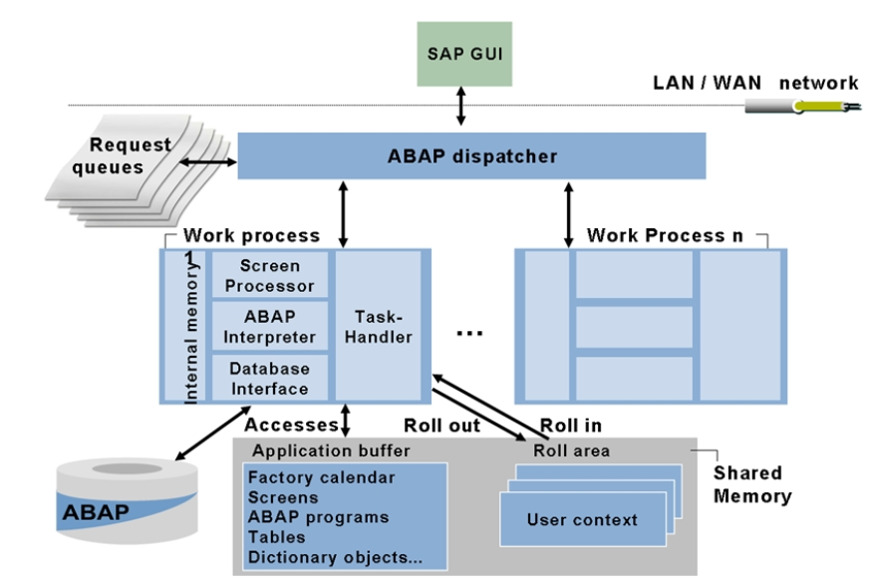
Process Flow for Requests

Slide 23
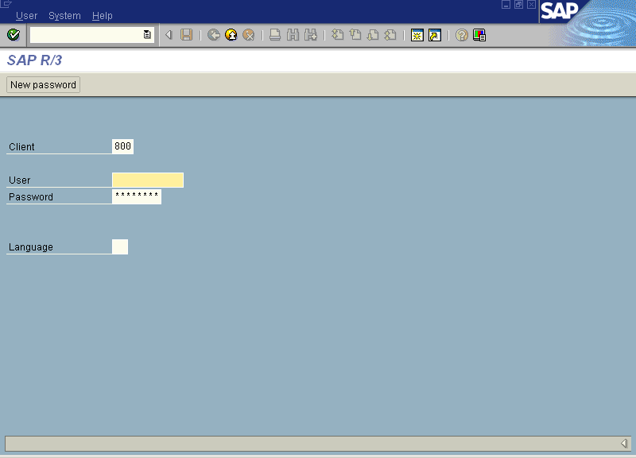
Logon Client
The term logon client has nothing to do the Client/Server-it is completely different.
The logon client refers to the number that the user types in the Client field on the logon screen.
The number entered here by the user corresponds to a set of rows within each client- dependent table within the database

Slide 24
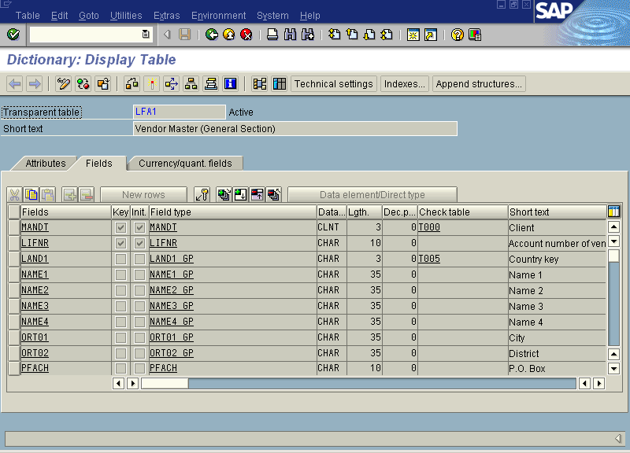
Client-Dependent and Client-Independent Tables
There are two types of tables in the R/3 database: client-dependent and client-independent.
A table is client-dependent if the first field is of type CLNT.
The length will always be 3; and by convention, this field is named mandt.
If the first field is not of type CLNT, the table is client independent

Slide 25
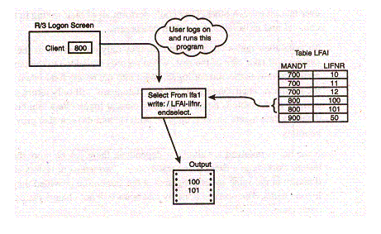
Client-Dependent and Client-Independent Tables
In the figure, the user logs on to client 800 and runs the program shown. This program selects rows from table lfa1 and writes out lfa1-lifnr. When this program is run, only two rows are selected: only those whose mandt equals 800. This happens automatically because the first field in the table is of the type CLNT.
There are five rows in the table, but the program writes out only those rows where mandt equals 800.
If the user were to log on to client 700 and run the same program, three rows of data would be found and written out. If the user were to log on to client 900, only one row of data would be found

Slide 26
Client-Dependent and Client-Independent Tables
The logon client mechanism divides the rows within a client-dependent table into distinct groups.
To access a different set of data, the user logs on and specifies a different client number.
The user master records (containing R/3 user IDs) are client-dependent.
Therefore, to gain access to a client, the system administrator must create a new user ID for you within that client
Developers and testers use the logon client mechanism to create and access multiple, independent set of data within a single table

Slide 27
Client-Dependent and Client-Independent Tables
The average R/3 installation has three systems: development, test, and production.
By default, each system comes with three clients installed: 000, 001, and 066.
It is common to have from three to six clients in the development and test systems, but rarely will you see more than one client in production

Slide 28
Using SAP’s Open SQL
ABAP/4 code is portable between databases.
To access the database in an ABAP/4 program you will code SAP’s Open SQL.
Open SQL is a subset and variation of ANSI SQL.
The ABAP/4 interpreter passes all Open SQL statements to the database interface part of the work process
There, they are converted to SQL that is native to the installed RDBMS.
For example, if you were running an Oracle database, your ABAP/4 Open SQL would be converted by the database interface to Oracle SQL statements.

Slide 29
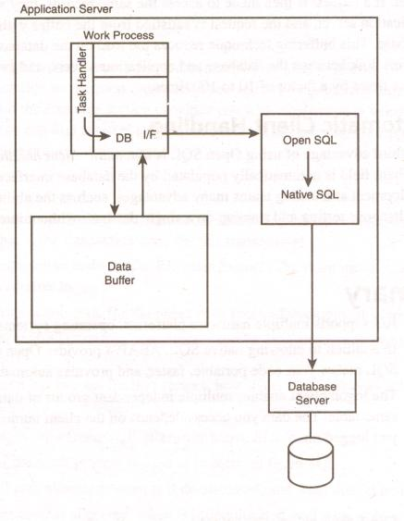
Using SAP’s Open SQL
If you use Open SQL, your SQL statements will be passed to the database interface.
Using Open SQL has three main advantages.
All of these advantages are implemented via the database interface

Slide 30
Portability
The first advantage is the fact that your SQL statements will be portable between databases.
For example, if for some reason your company wanted to switch from an Oracle to an Informix database, it could change the database, and your ABAP/4 code would continue to run without modification

Slide 31
Buffering Data on the Application Server
Secondly, the database interface buffers information from the database on the application server.
When data is read from the database, it can be stored in the buffers on the application server.
If a request were then made to access the same records, they would already be on the application server, and the request is satisfied from the buffer without having to go to the database.
This buffering techniques reduces the load on the database sever and on the network link between the database and the application servers, and can speed up database access time by a factor of 10 to 100 times.

Slide 32
Automatic Client Checking
The third advantage of using Open SQL is automatic client handling.
With Open SQL, the client field is automatically populated by the database interface.
This gives your development and testing teams many advantages, such as ability to perform multiple simultaneous testing and training on a single database without interference from each other

Slide 33
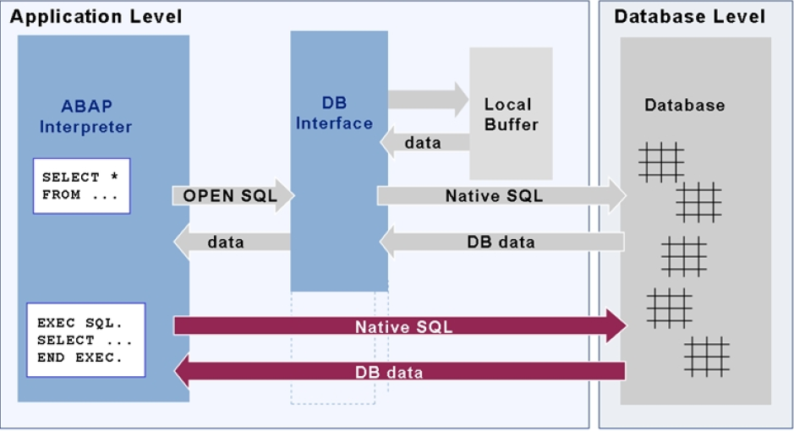
Database Query Flow

Slide 34
SAP R/3 – An Introduction
SYSTEMS APPLICATIONS and PRODUCTS
in Data Processing
R: Real Time
3: 3 Tier Client/Server Architecture

Slide 35
SAP – An Introduction
ERP ( Enterprise Resource Planning) Product
Name of the Company and its Product
German Based
ERP Market Leader
Industry Specific Best Practices

Slide 36
SAP Logon
A utility to logon to SAP
Choose an available SAP system
Program connects to the message server of that system and obtains the address of a suitable Application Server
Starts a SAP GUI (Graphical User Interface)
SAP GUI Starts the logon Screen
The user can open multiple sessions
Applications are run within a session
The SAP GUI is based on Windows Style and is available for several Platforms, providing the same functions for each

Slide 37
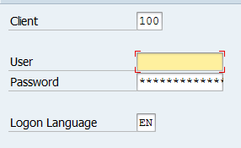
Basic Navigation
Logging on to SAP
Client
Username
Password
Logon Language
Notes:
Client: A unit in the R3 system, with separate set of Master data and its own set of Tables.
Client is used to group data within Database
The users have access to data for the specific Client
Once logged on, the user can work on several sessions

Slide 38
Demo
SAP Logon

Slide 39
Basic Navigation
Transaction Code
Acronym to access menu path
Sequence of Screens with Input and Output fields for Processing
Possible Command Field Entries
/nxxxx – to call Transaction xxxx
/n – cancel Transaction
/oxxxx – to Call Transaction xxxx in a new Session
/o – display an overview of Sessions

Slide 40
Basic Navigation
Several options are available to log off from system
Menu Bar System Logoff
Choose Yellow Arrow in the SAP EASY ACESS Menu. If several sessions are open, it only closes the session
Enter /nend in the command field
Enter /nex in the command field.

Slide 41
Basic Navigation
The Commonly Used Transaction Codes are
SE80 : Object Navigator (ABAP Development Workbench)
SE38 : ABAP Editor
SE37 : Function Builder
SE11 : ABAP Dictionary
SE21 : Package Builder
SE91 : Message Maintenance

Slide 42
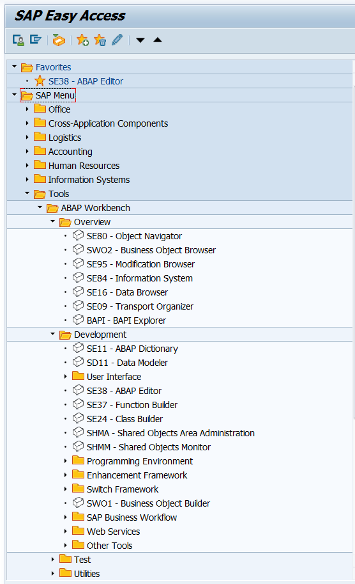
ABAP Workbench tools
The ABAP Workbench is a collection of tools you use to develop, test and run ABAP programs
Frequently Used Tools
ABAP Editor
ABAP Dictionary
Screen Painter
Menu Painter
Function Builder

Slide 43
Review Question
1. ______is like an operating system for R/3.
2. An __________ interprets the ABAP/4 programs and manage the input and output for them.
3. A __________is memory that is allocated to contain the characteristics of a user that is logged on the R/3 system.
4. The ____ is used to cancel the transaction.
5. ______ is a collection of tools you use to develop, test and run ABAP programs
Notes:
Question 1: Basis
Question 2: Application server
Question 3: User Context
Question 4: True

Slide 44
Summary
In this lesson, you have learnt:
The R/3 System Architecture
The Application Server Architecture
The meaning of Logon Client
Advantages of using SAP’s Open SQL
The Basics of SAP
How to Log on to SAP and do the Basic Navigations

